Slide 1
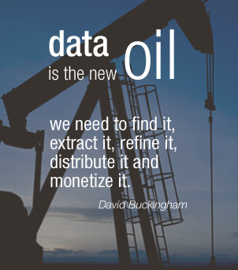


Slide 2
Route to find diamond form data is like moving in a maze
Data
Answer

Slide 3
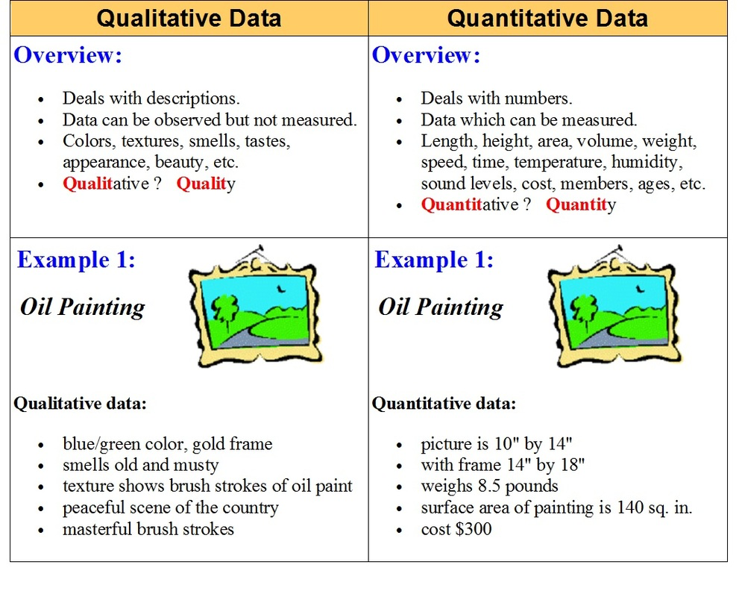

Slide 4
Data – Types of Variables
Quantitative variables take numerical values whose "size" is meaningful. Quantitative variables answer questions such as "how many?" or "how much?"
For example, it makes sense to add, to subtract, and to compare two persons' weights, or two families' incomes: These are quantitative variables. Quantitative variables typically have measurement units, such as pounds, dollars, years, volts, gallons, megabytes, inches, degrees, miles per hour, pounds per square inch, BTUs, and so on.
Qualitative Variables: Some variables, such as social security numbers and zip codes, take numerical values, but are not quantitative: They are qualitative or categorical variables.
The sum of two zip codes or social security numbers is not meaningful. The average of a list of zip codes is not meaningful.
Qualitative and categorical variables typically do not have units. Qualitative or categorical variables—such as gender, hair color, or ethnicity—group individuals. Qualitative and categorical variables have neither a "size" nor, typically, a natural ordering to their values. They answer questions such as "which kind?" The values categorical and qualitative variables take are typically adjectives (for example, green, female, or tall). Arithmetic with qualitative variables usually does not make sense, even if the variables take numerical values. Categorical variables divide individuals into categories, such as gender, ethnicity, age group, or whether or not the individual finished high school

Slide 5
Statistics - Refresher
Statistics is the science of collecting, organizing, summarizing, analyzing and interpreting data.
Descriptive Statistics: When performing descriptive statistics you collect, organize, summarize, and graphically present data; then you are able to make conclusions about said data.
Inferential Statistics: Inferential statistics are used when you want to make predictions and inferences about a larger group (a whole population) from data that was collected from a smaller group (a sample population)

Slide 6
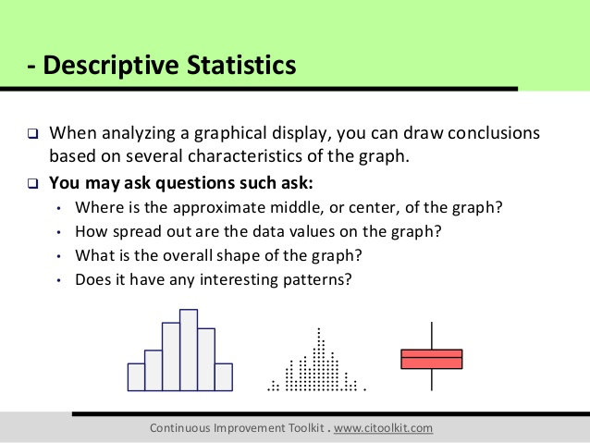

Slide 7

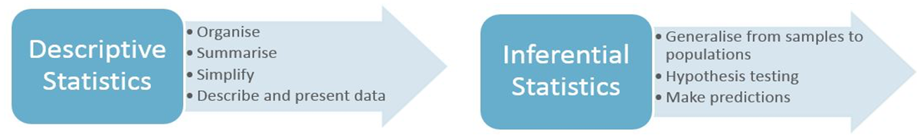

Slide 8
Common Terms
Distribution: The pattern of values in the data, showing their frequency of occurrence relative to each other.
Function: A function is a relationship where each input number corresponds to one and only one output number
Model: A model is a formula where one variable (response or outcome variable) varies depending on one or more independent variables (covariates). A model tries to establish a relationship among data points. One of the simplest models we can create is a Linear Model where we start with the assumption that the dependent variable varies linearly with the independent variable(s). Linear Model has a “constant” rate of change. An exponential Model has a “constant percent” rate of change. So if a population grows by 10 people per year(given the initial population as 100), it’s a linear growth and the model will be:
P(t)=100+10t
But if a population grows by 10% each year(given the initial population as 100), its an exponential growth and the model will be
P(t)=100(1+10%)^t
A statistical model is a “mathematical” description of data

Slide 9
Measures of Central Tendency
Central tendency refers to the most typical value in a set of numbers
Median: is the half-way point of data. The median is the number that divides the (ordered) data in half—the smallest number that is at least as big as half the data. At least half the data are equal to or smaller than the median, and at least half the data are equal to or greater than the median. If the distribution is skewed, median is typically used to describe the center.
Mode: The value that has highest frequency. Most frequently occurring value in the data set or the most popular value. It’s the only measure of central tendency that can be used with nominal variables.
Mean: The mean (more precisely, the arithmetic mean) is commonly called the average. It is the sum of the data, divided by the number of data. If there are outliers in data, mean can be strongly influenced. In such cases, median is more appropriate.
For qualitative and categorical data, the mode makes sense, but the mean and median do not.

Slide 10
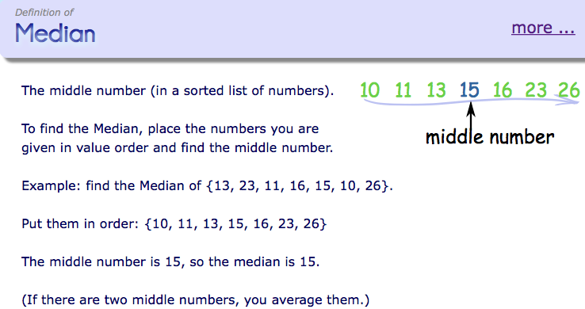
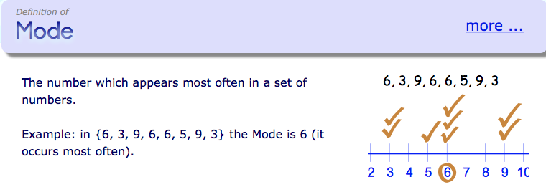

Slide 11
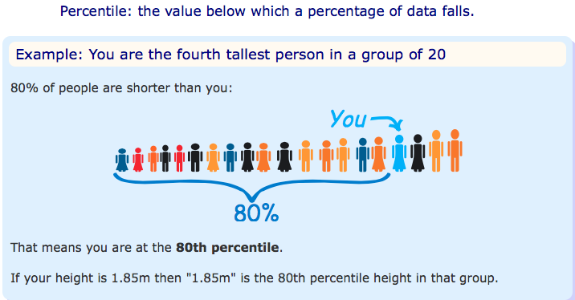
Percentiles:
Assume that the elements in a data set are rank ordered from the smallest to the largest.
The values that divide a rank-ordered set of elements into 100 equal parts are called percentiles.

Slide 12
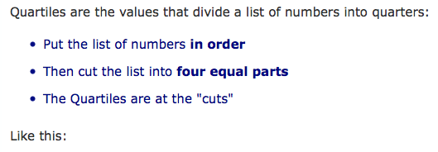
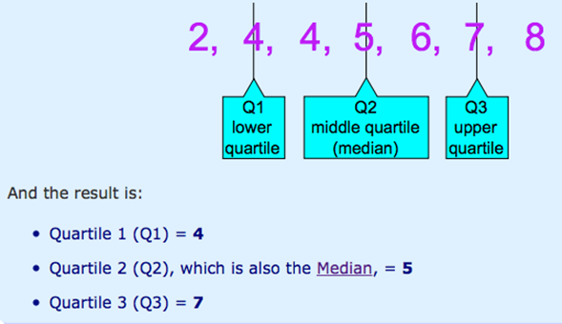
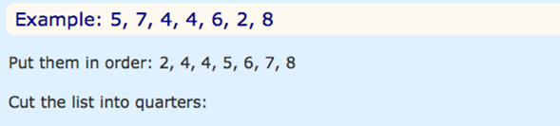
Quartiles:
The median of a data set is located so that 50% of the data occurs to the left of the median (and 50% of the data occurs to the right of the median). There is no reason to restrict our attention to the 50% level. For example, we can find a point where 25% of the data occurs on its left and 75% to its right. These points are known as the “first quartile” and “third quartile” respectively

Slide 13
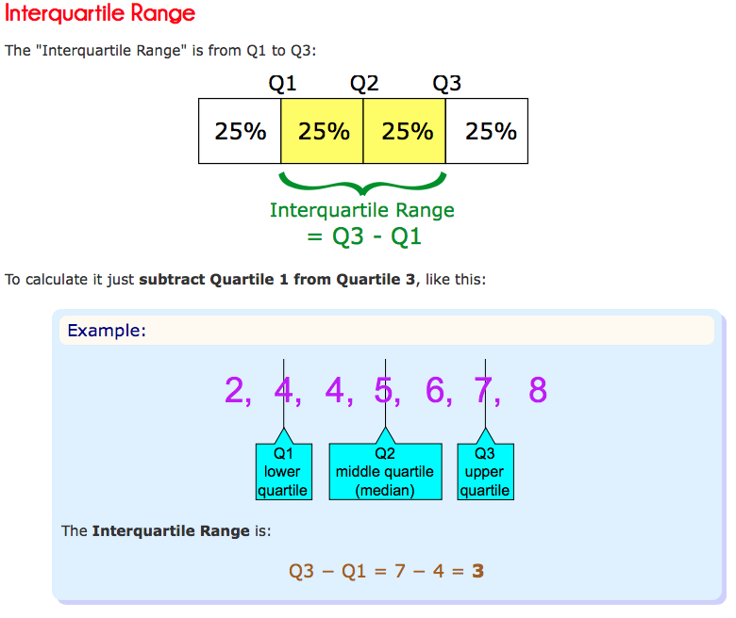

Slide 14


Measures of Dispersion
These measure the extent of variability in data. Range, interquartile range and standard deviation are the three commonly used measures of dispersion.
Range: Difference between the largest and smallest observation in the data.
Inter-quartile Range(IQR): Difference between the 25th and 75th percentile. It describes the middle 50% of the observations.
Standard Deviation: It is the measure of spread of data about the mean. It measures roughly how far off the entries are from their average. It tells us how the data is spread out. The more the SD, the more spread out data is. Since its simply a measure, it can’t be negative.
When you add a constant to a list of values, the average also adds up by constant but the SD doesn’t change. If you multiply by a constant, the new average and new SD also get multiplied by that constant.
Variance: Mean of Squared deviations. Or simply, it’s the square of Standard deviation.
5. Outlier: An outlier is a data point that lies outside the general range of the data. In the presence of outliers, the mean of the dataset will be significantly affected. In such cases, median makes for sense.
Outlier < Q1 – 1.5*(IQR)
Outlier > Q3 + 1.5*(IQR)

Slide 15
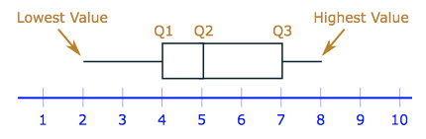
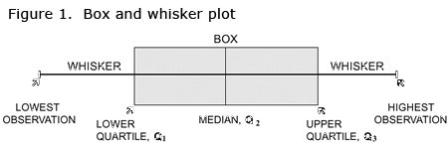
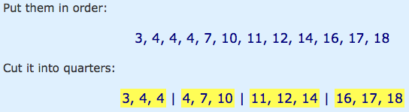


Box and Whisker Plot:
It’s a visual representation of Min, Max, Median
and quartiles on a single graph.
Its mainly used for identifying outliers easily.
Outlier < 4 – 1.5*11 = 4-16.5 = - 12.5
Outlier > 15 + 1.5*11 = 15 +16.5 = 31.5

Slide 16
Some more Terms…
Significance of SD: SD gives you an insight that how much your data is spread out. With the help of SD you can compare 2 datasets more effectively.
If the average of 2 data sets is same, it does not means that the SD will be same. E.g 99,100,101 and 0 , 100 , 200 have same mean i.e 100 but they have different standard deviations. The SD of (99,100,101) is only 1 but the SD of (0,100,200) is 100 which is very large.
Lets say the average starting salary in a company is 80000$. Would you consider joining it? There may be few outliers which may have skewed the average. Additionally, if you know that SD is 2000$, you may consider joining it.

Slide 17
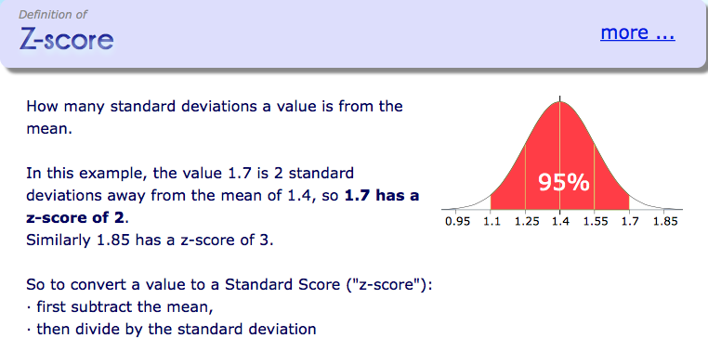
Some more Terms…
Z Score: A z-score is the measure of the number of standard deviations a particular data point is away from the mean i.e how many standard deviation away from mean is the observed value. Its also called Z-value
Z = Deviation from mean/Standard Deviation

Slide 18
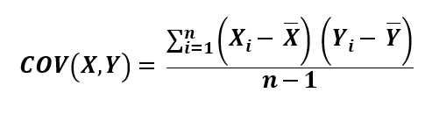
Covariance
covariance is a measure of the joint variability of two random variables. If the greater values of one variable mainly correspond with the greater values of the other variable, and the same holds for the lesser values, (i.e., the variables tend to show similar behavior), the covariance is positive. In the opposite case, when the greater values of one variable mainly correspond to the lesser values of the other, (i.e., the variables tend to show opposite behavior), the covariance is negative. The sign of the covariance therefore shows the tendency in the linear relationship between the variables
If you calculate the covariance between one dimension and itself, you get the variance.

Slide 19
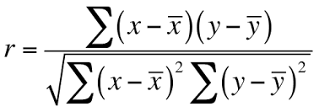
Correlation
Correlations are mathematical relationships between variables. Correlation Coefficient (r) is a number between -1 and 1. It measures linear association i.e how tightly the points are clustered about a straight line. The correlation is said to be linear if the data points lie in an approximately straight line.
A correlation between two variables doesn’t necessarily mean that one caused the other or that they’re actually related in real life. A correlation between two variables means that there’s some sort of mathematical relationship between the two.
Correlation is Positive when the values increase together
Correlation is Negative when one value decreases as the other increase
Correlation = Covariance(X,Y) / SQRT( Var(X)* Var(Y))
.

Slide 20
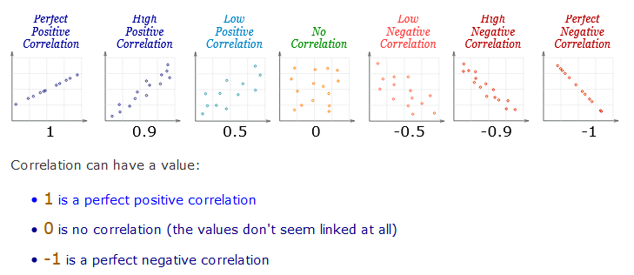
Correlation

Slide 21
Multi-colinearity
.
Multi-colinearity refers to the situation when 2 independent variables are highly correlated. Multi-collinearity generally degrades the performance of linear regression model.
Multi-collinearity means that several variables are essentially measuring the same thing. It doesn't add to the predictive capability of the model and it may make the model fit less well. Since you are predicting an outcome, you want your factors to be independent. Correlation indicates two or more factors are providing your model with similar data which will decrease the model's ability to accurately predict.
Example: Predicting home prices. Square feet and number of bedrooms could be two of your factors considered. But logically you could see how these two measurements would be correlated; likely positive correlation. What if a home you want to predict for has one room but the area of a 5 bedroom home? Your model is 'expecting' 5 bedrooms and that bedrooms add value to the home. Your model will predict price using one room but not as accurately as it would if the bedrooms only slightly varied from your model. Your model would more accurately predict the price if, in this example, bedrooms were removed AND the regression model was created again.

Slide 22
Probability density function
.
PDF is used to specify the probability of the continuous random variable falling within a particular range of values, as opposed to taking on any one value.
This probability is given by the integral of this variable's PDF over that range—that is, it is given by the area under the density function but above the horizontal axis and between the lowest and greatest values of the range. The probability density function is nonnegative everywhere, and its integral over the entire space is equal to one.
The normal distribution is useful because of the central limit theorem In its most general form, under some conditions (which include finite variance), it states that averages of samples of observations of random variables independently drawn from independent distributions converge in distribution to the normal, that is, they become normally distributed when the number of observations is sufficiently large.
The normal distribution is sometimes informally called the bell curve

Slide 23
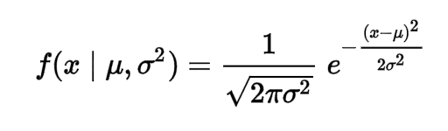
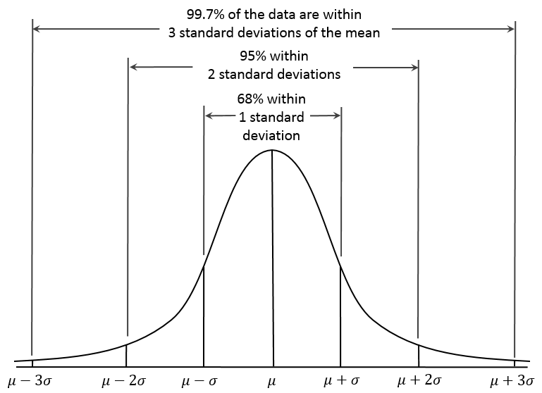

Probability density function
The probability density of the normal distribution is
.

Slide 24
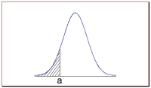
Probability density function
.
Probability and the Normal Curve
The normal distribution is a continuous probability distribution. This has several implications for probability.
The total area under the normal curve is equal to 1.
The probability that a normal random variable X equals any particular value is 0.
The probability that X is greater than a equals the area under the normal curve bounded by a and plus infinity (as indicated by the non-shaded area in the figure below).
The probability that X is less than a equals the area under the normal curve bounded by a and minus infinity (as indicated by the shaded area in the figure below).
Additionally, every normal curve (regardless of its mean or standard deviation) conforms to the following "rule".
About 68% of the area under the curve falls within 1 standard deviation of the mean.
About 95% of the area under the curve falls within 2 standard deviations of the mean.
About 99.7% of the area under the curve falls within 3 standard deviations of the mean.

Slide 25
Central limit theorem
.
The central limit theorem states that under certain (fairly common) conditions, the sum of many random variables will have an approximately normal distribution.
An essential component of the Central Limit Theorem is that the average of your sample means will be the population mean.
In other words, add up the means from all of your samples, find the average and that average will be your actual population mean.
Similarly, if you find the average of all of the standard deviations in your sample, you’ll find the actual standard deviation for your population.
A simple example of this is that if one flips a coin many times the probability of getting a given number of heads in a series of flips will approach a normal curve, with mean equal to half the total number of flips in each series.
A simple example of the central limit theorem is rolling a large number of identical, unbiased dice. The distribution of the sum (or average) of the rolled numbers will be well approximated by a normal distribution.

Slide 26
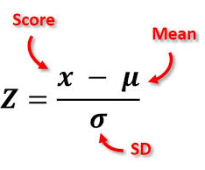
Z Score
.
Simply put, a z-score is the number of standard deviations from the mean a data point is.
Z-scores are expressed in terms of standard deviations from their means.
Z-scores are a way to compare results from a test to a “normal” population.

